Slide 1
Airbnb Data Analysis
Chunyu Chen
Zongjie Yin

Slide 2
Background
Widely-used
Two-sided market
Landlord
Vacant Houses
Renter
Travelling

Slide 3
Purpose
Using provided information to predict price of given house that is in the Airbnb list in NY state.
For renter:
Provide the relative price range for similar houses in order to save rent
For landlord:
Provide the relative price range for similar houses in order to increase competitiveness

Slide 4
Data
Data from Kaggle: https://www.kaggle.com/c/airbnblala/data
Each row in the data set means one house in the Airbnb list in NY state
There are total 29142 rows × 96 columns in the data set
Columns information includes:
Housing basic information: Url link, location, house rules, pictures...
Household information: responding time, listing houses count...
Review scores: overall rating, accuracy, cleanliness, communications...

Slide 5
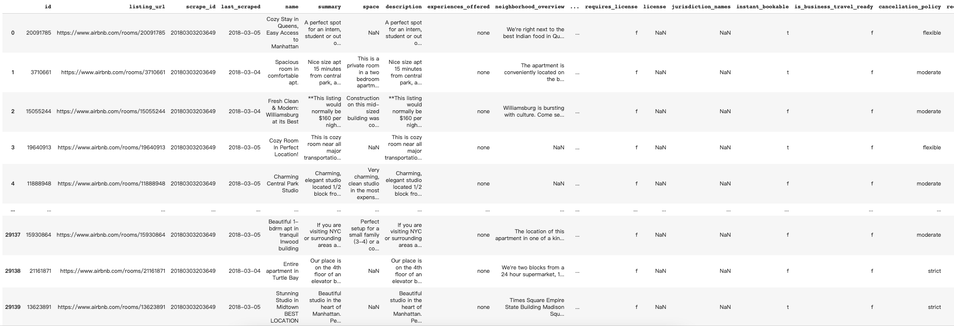
Example of data
Feature spaces: columns in the data-set (does not includes price)
Target variable: price of the given house

Slide 6
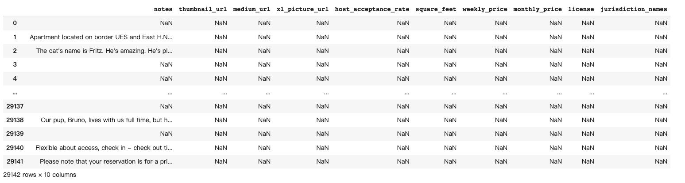
Data Cleaning
Outliers;
Price of house should > 0 (25 rows house price = 0)
Missing values;
10 columns that contain missing values over 50%
We delete 10 columns that having missing value over 50% and 25 rows with house price = 0.

Slide 7
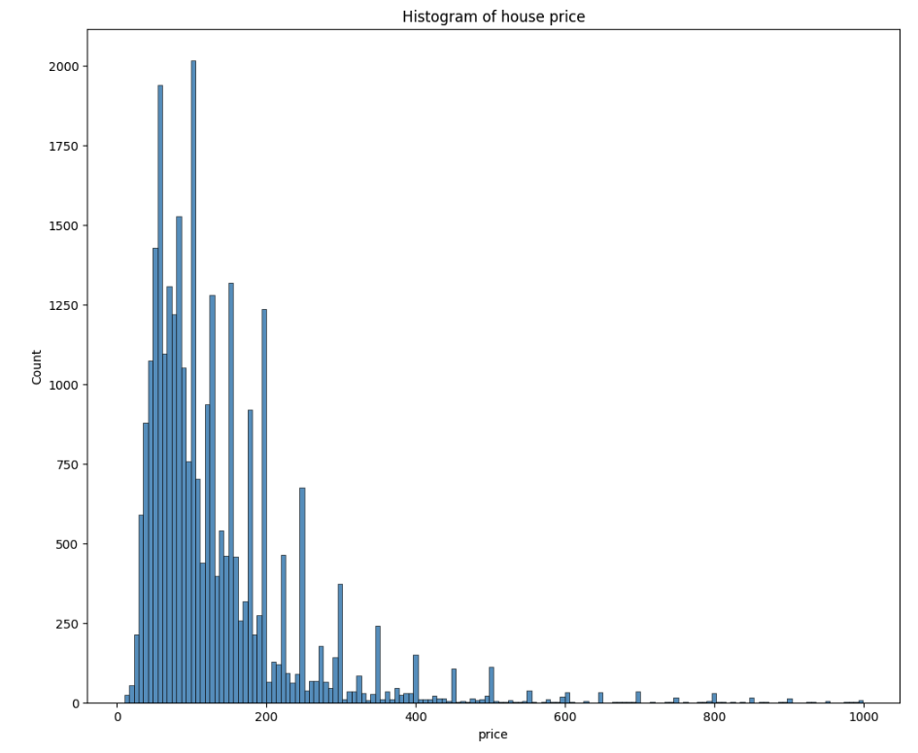
Data Remain After Cleaning
There are 29117 rows × 86 columns left
32 columns are numerical variables
54 columns are non-numerical variables including texts, ordinal data, nominal data…

Slide 8
Data Visualization

Slide 9
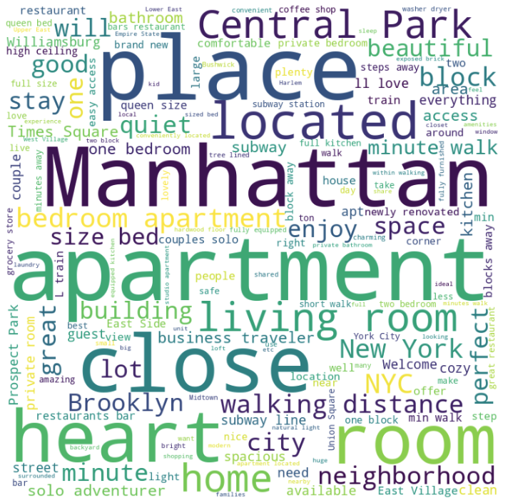
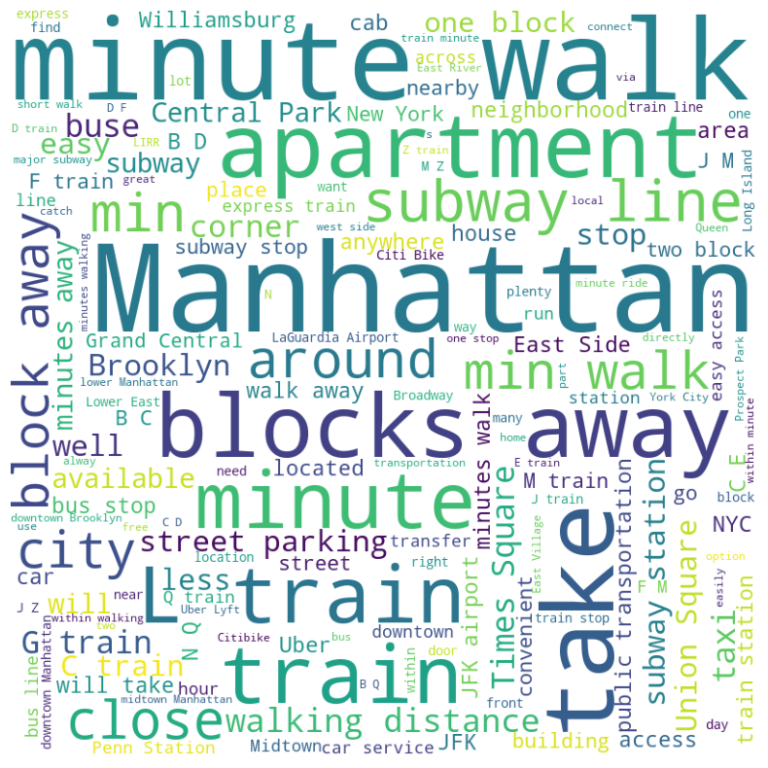
Word Could
Summary Column
Transit Column

Slide 10
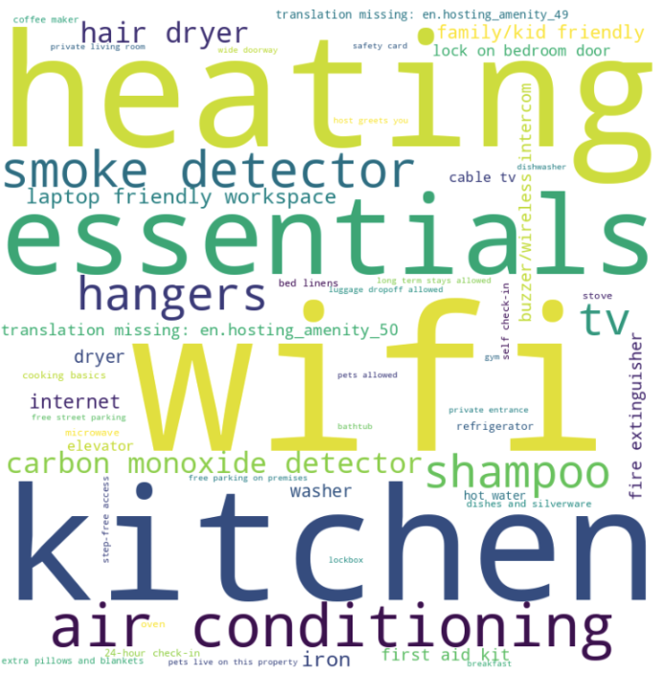

Word Could
Amenities Column
House rules Column

Slide 11
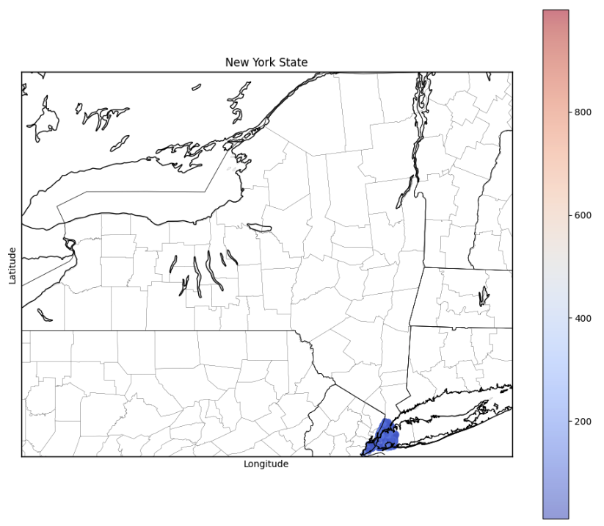
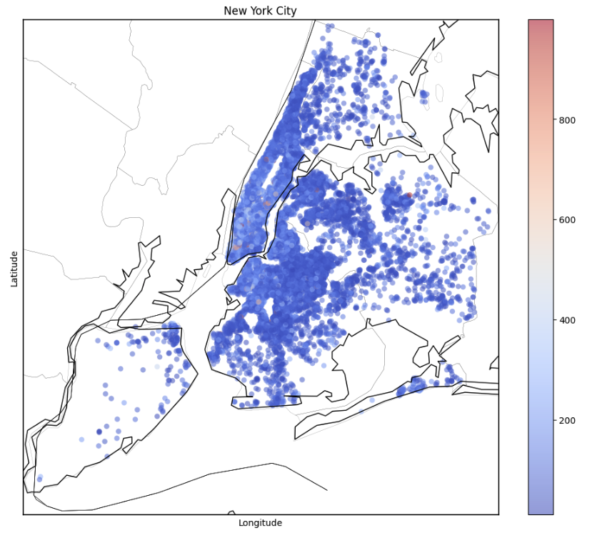
Price V.S. Location of House
Manhattan
Queens
Brooklyn
Staten Island

Slide 12
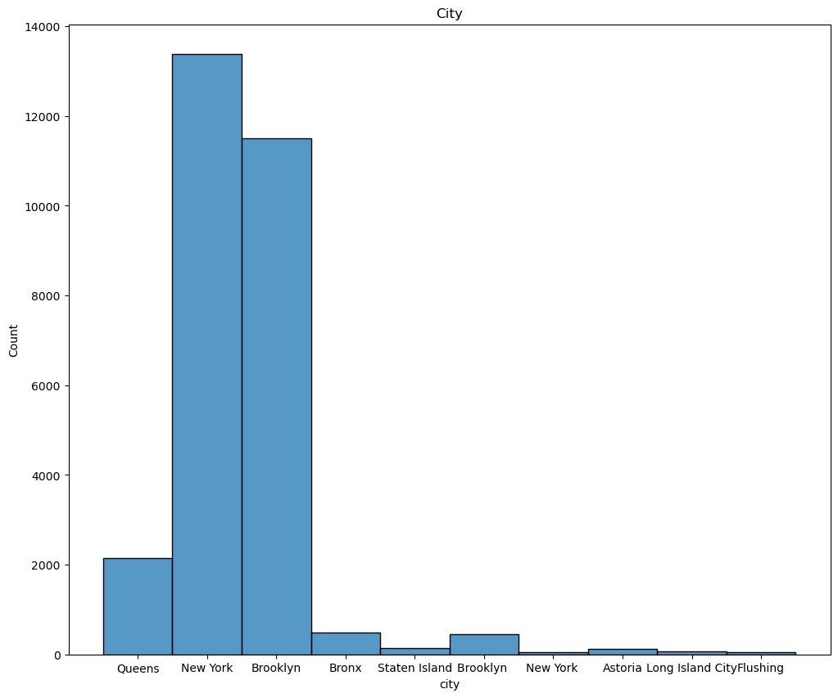
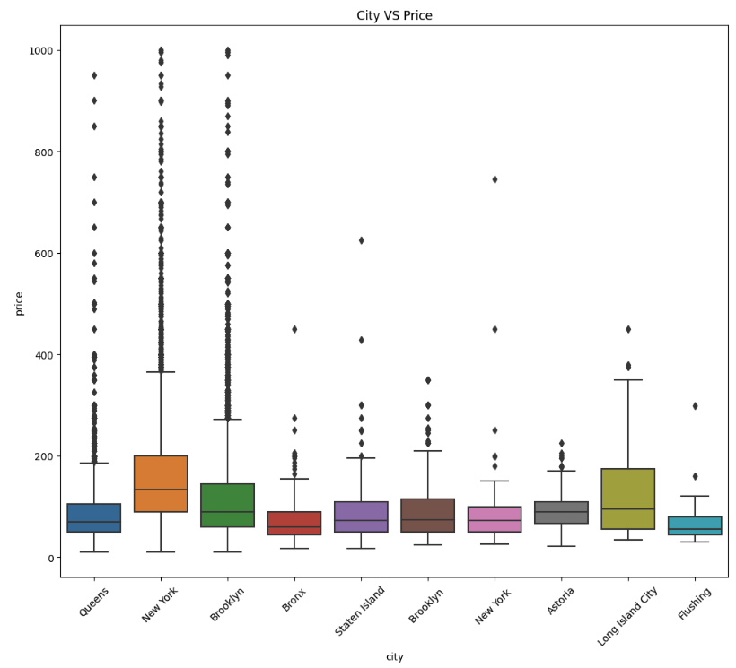
House Location as City

Slide 13
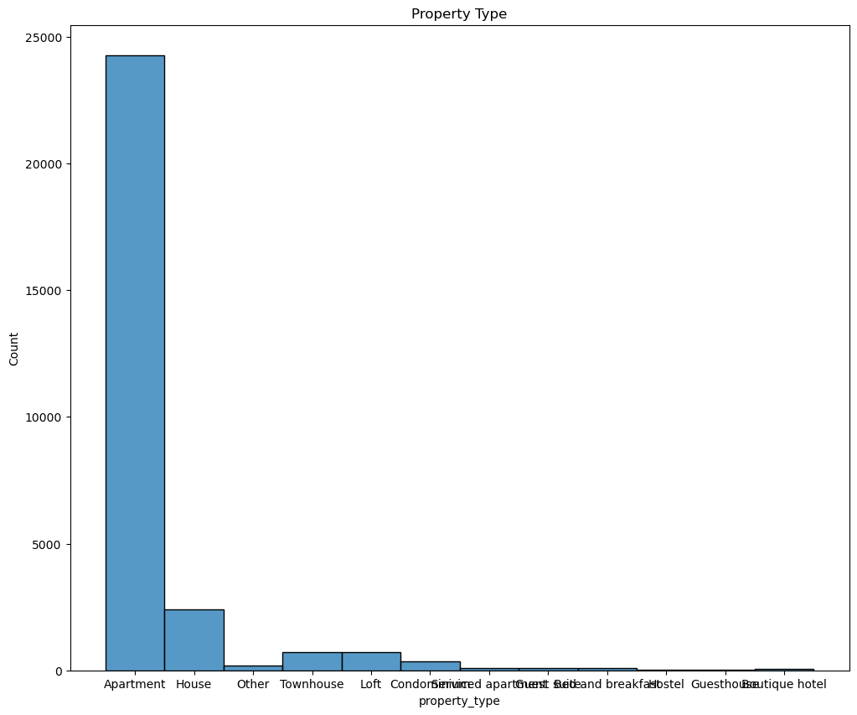
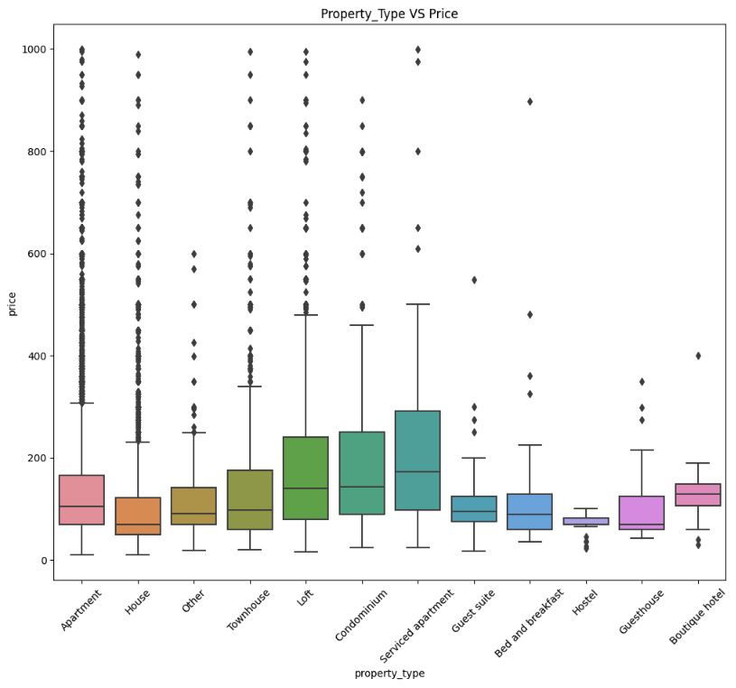
House Type

Slide 14
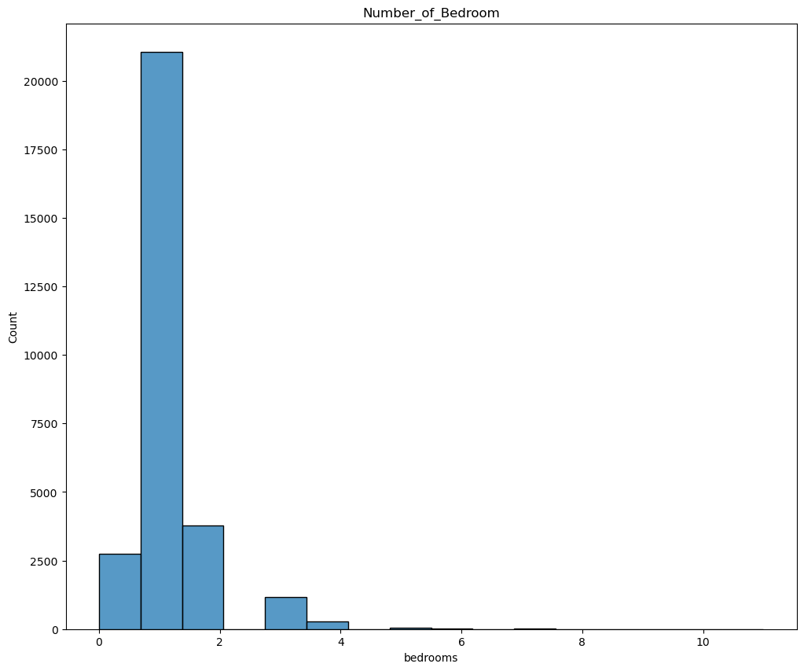
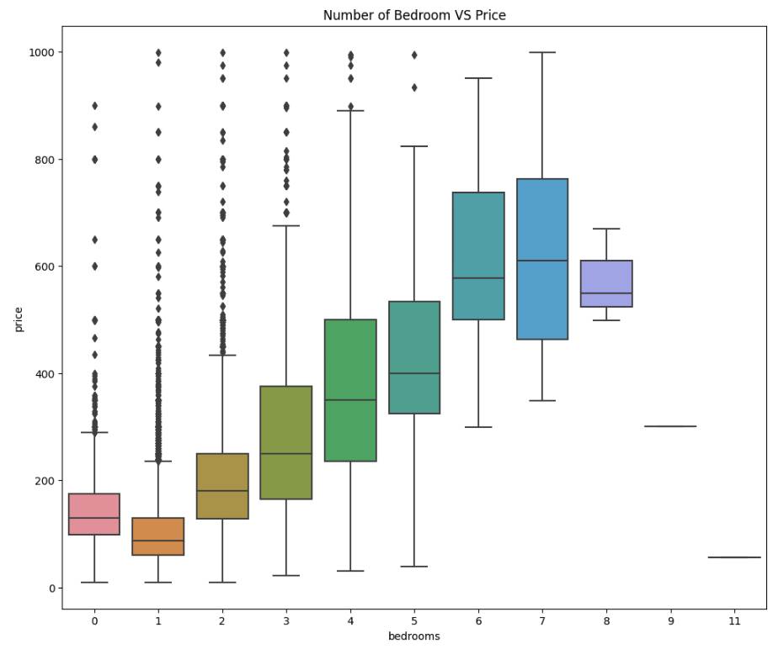
Bedroom Number

Slide 15
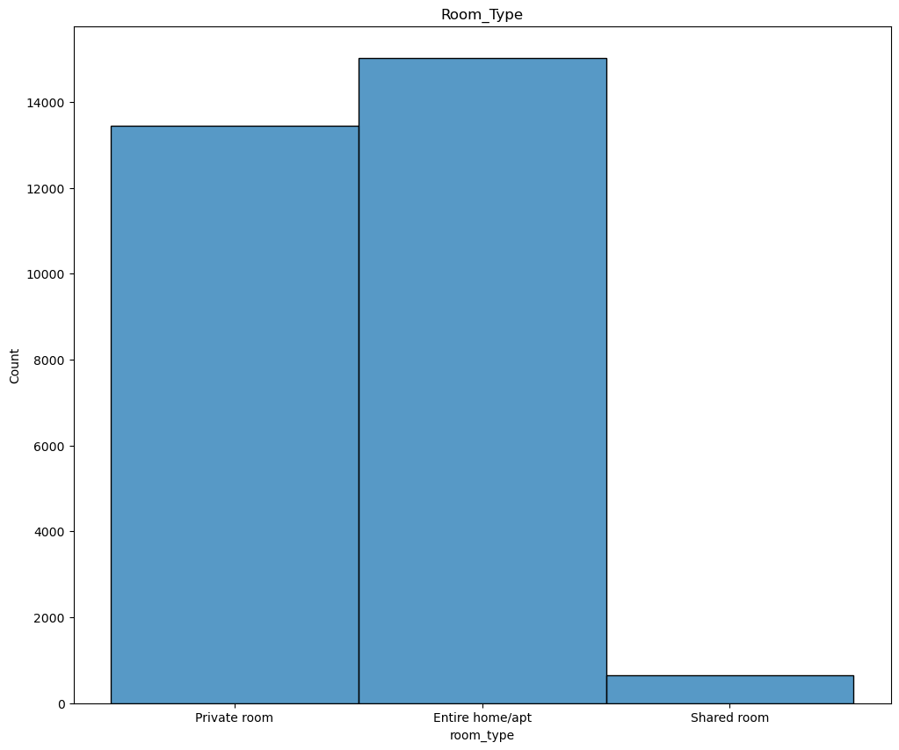
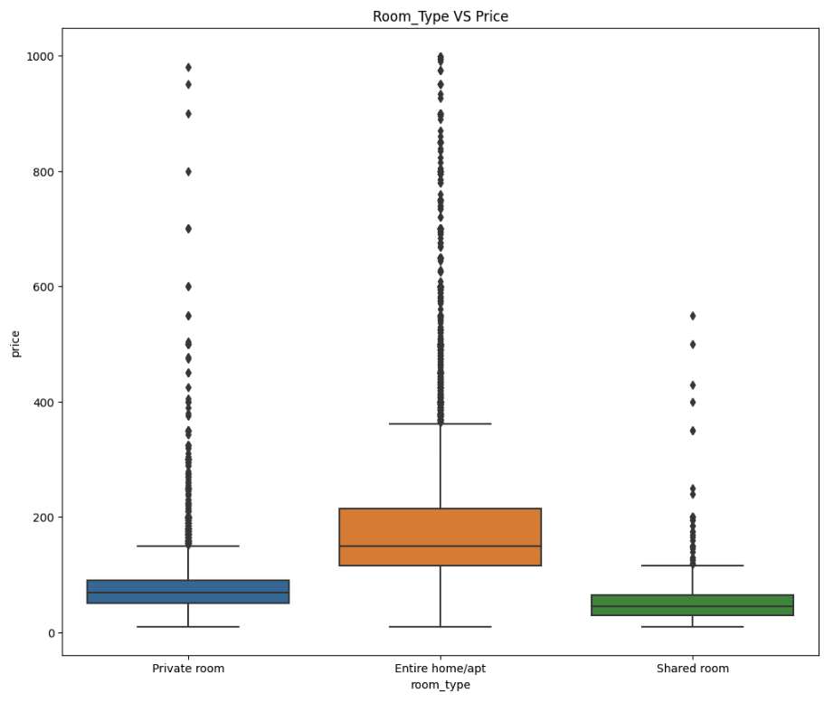
Room Types

Slide 16
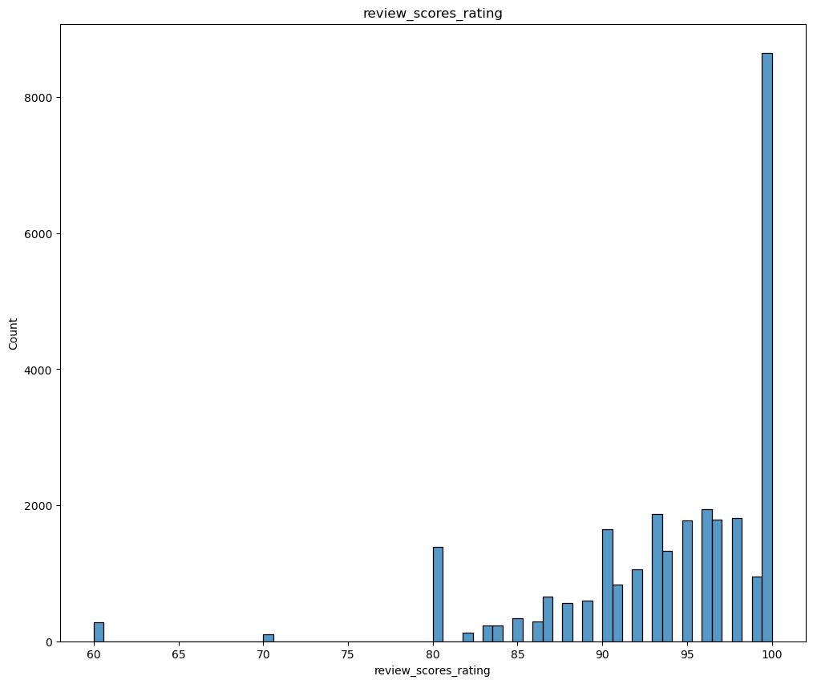
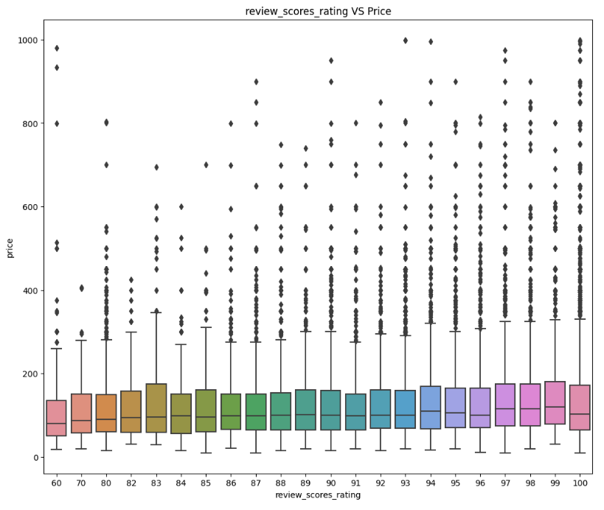
Rating Scores

Slide 17
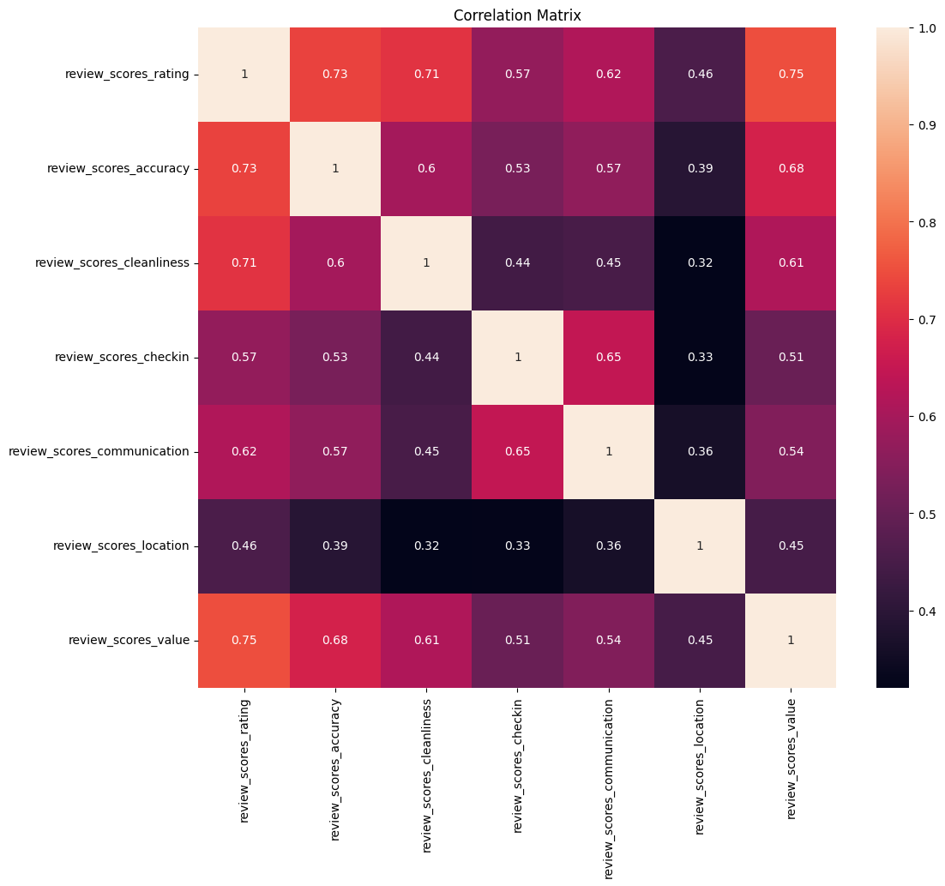
Review Scores Correlation Matrix

Slide 18
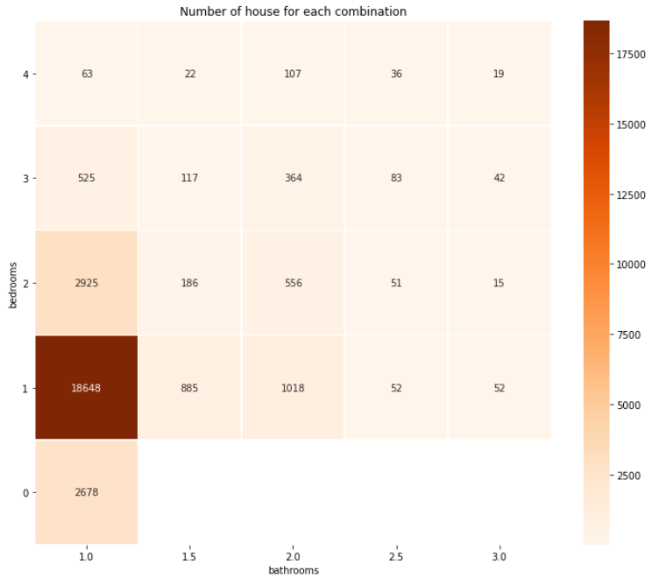
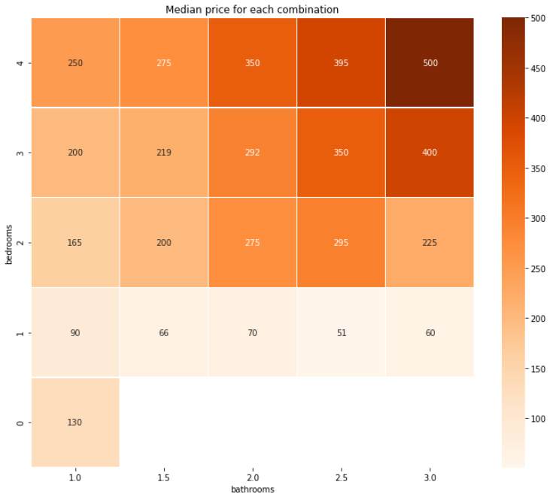
Bathrooms V.S Bedrooms

Slide 19
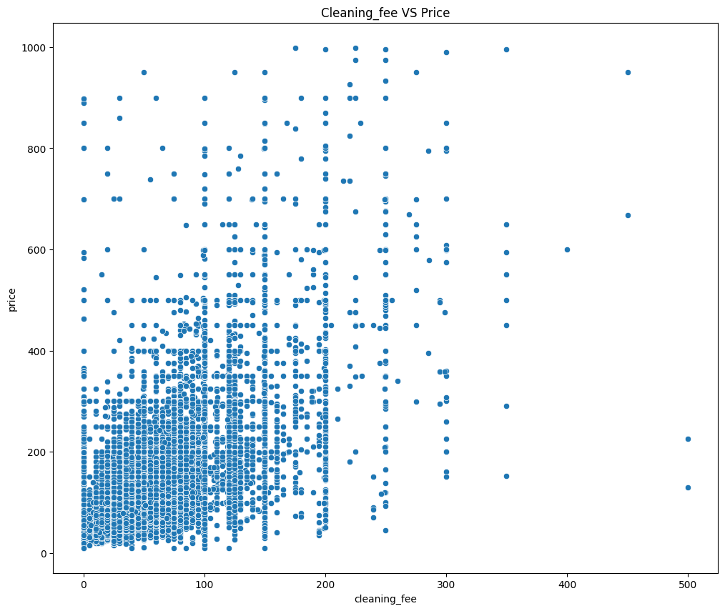
Cleaning Fee V.S. Price

Slide 20
Machine Learning

Slide 21
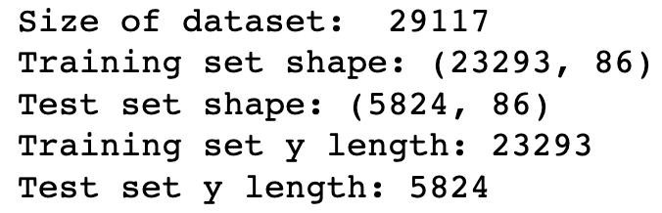
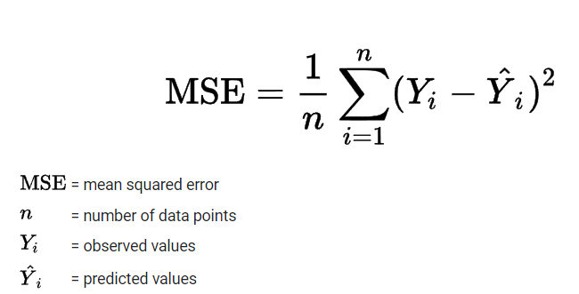
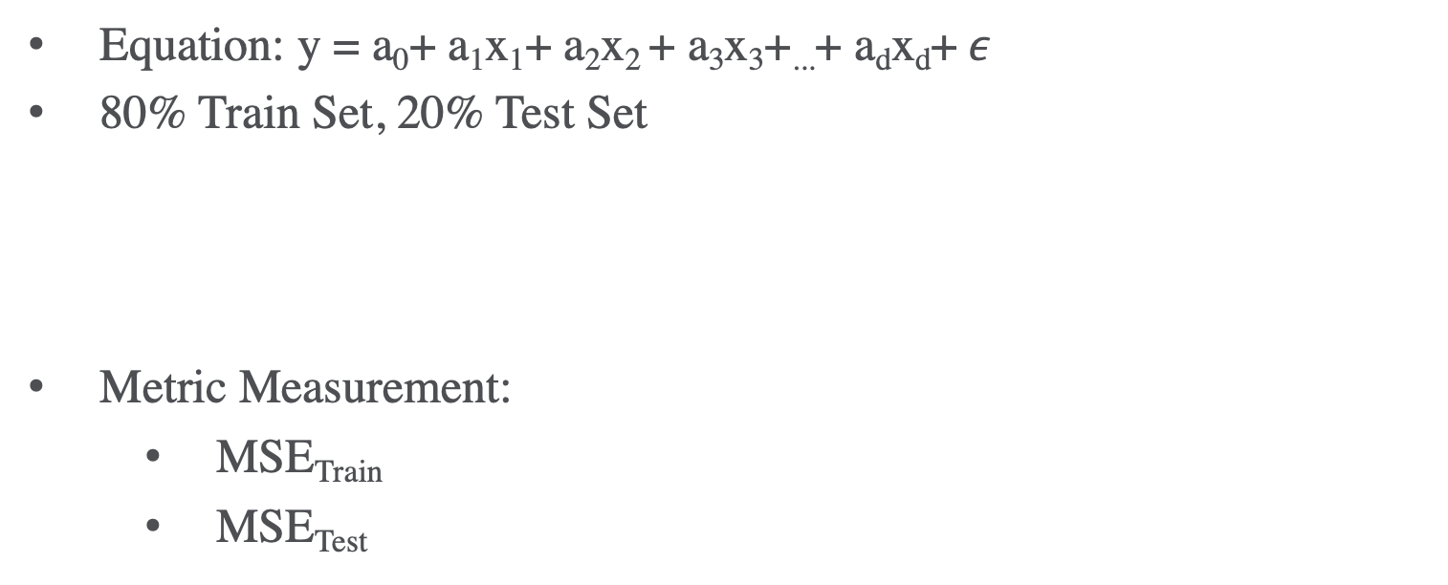
Linear Regression
Equation: y = a₀+ a₁x₁+ a₂x₂ + a₃x₃+...+ a_{d}x_{d}+$ε$
80% Train Set, 20% Test Set
Metric Measurement:
MSE_{Train}
MSE_{Test}

Slide 22
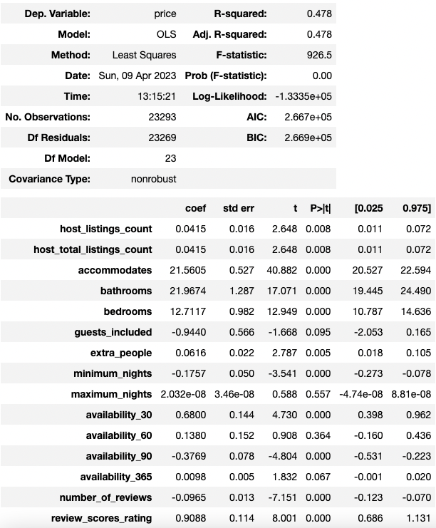
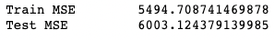
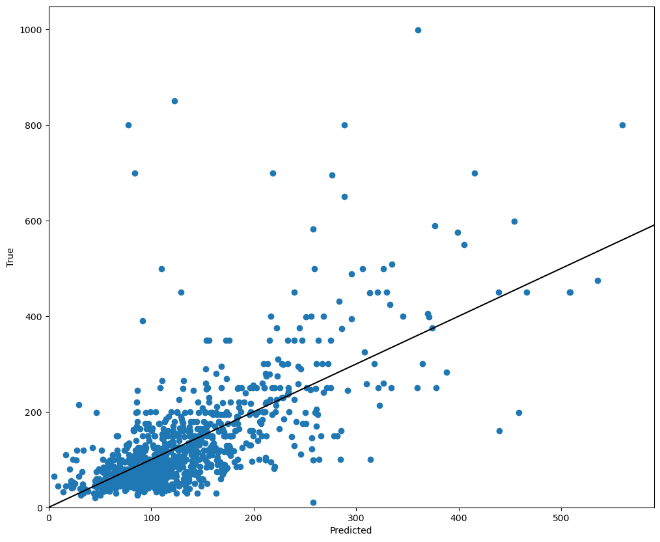
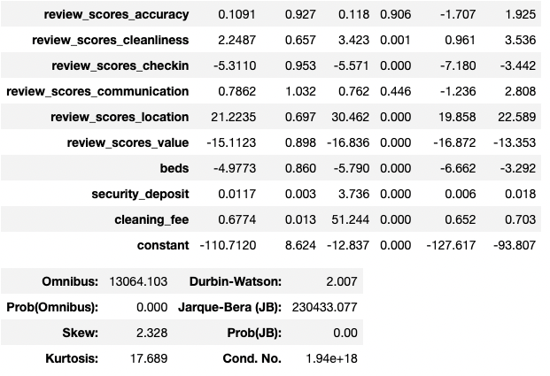
Process
Only includes real-valued data:

Slide 23
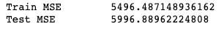

Process
After delete columns with p-value>= 0.05:

Slide 24
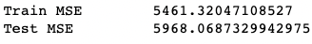

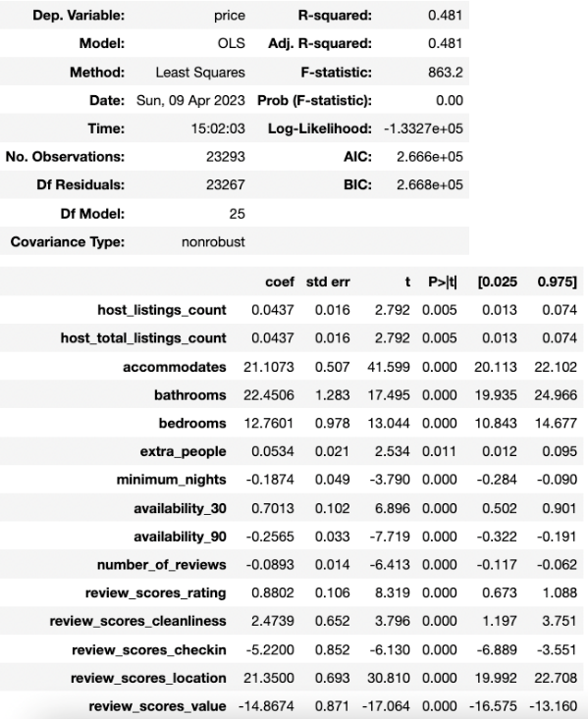
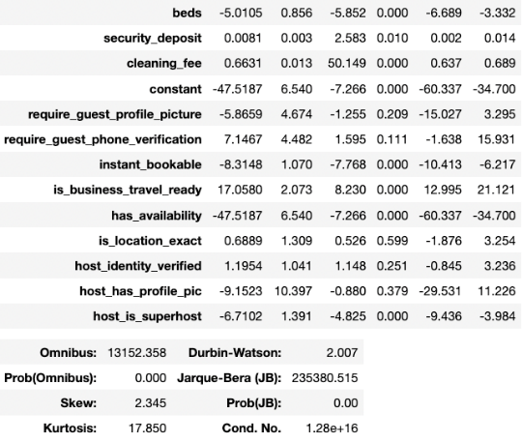
Process
Includes Real-valued data and Boolean data:

Slide 25
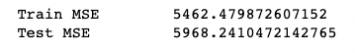

Process
After delete columns with p-value>= 0.05:

Slide 26
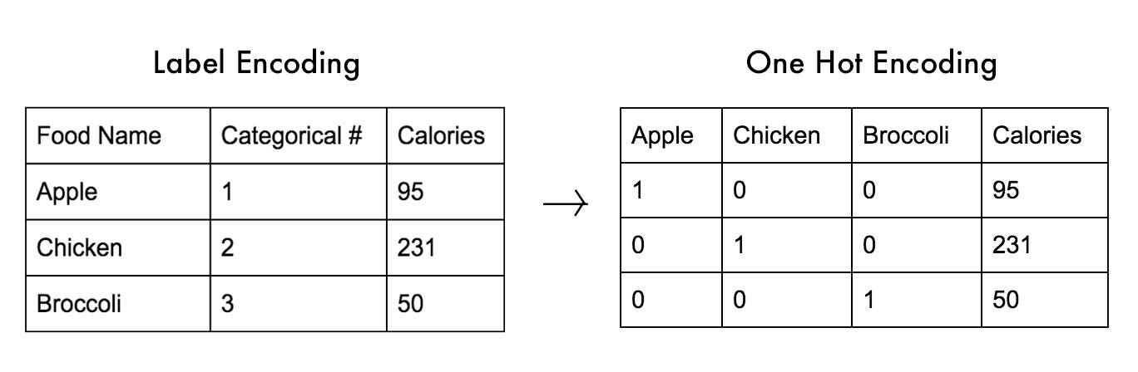
Categorical Data Using One-hot encoding Example
For this data set:
5 Columns → property_type, room_type, bed_type, cancellation_policy, host_response_time

Slide 27
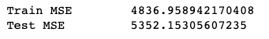
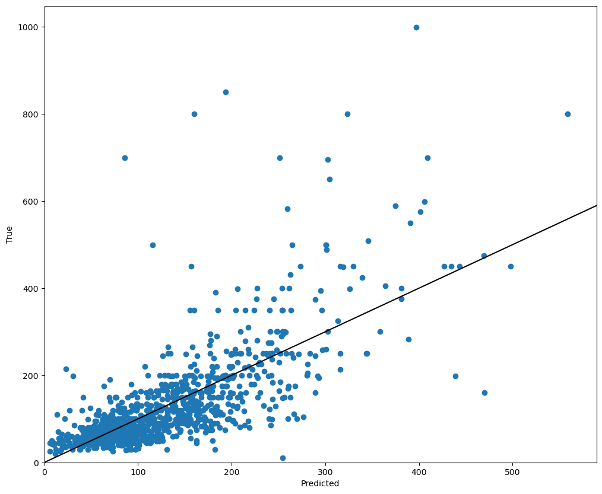
Process
Includes Real-valued data, Boolean data and Categorical data:

Slide 28
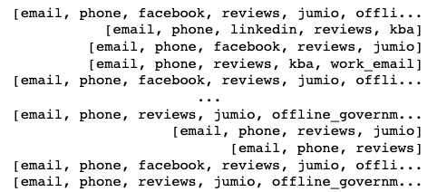
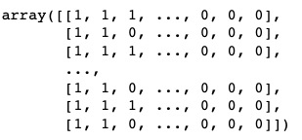
Set Data Using Many-hot encoding Example
For this data set:
1 Column → host_verifications

Slide 29
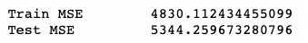

Process
Includes Real-valued data, Boolean data, Categorical data and Set data:

Slide 30
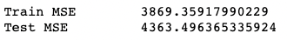
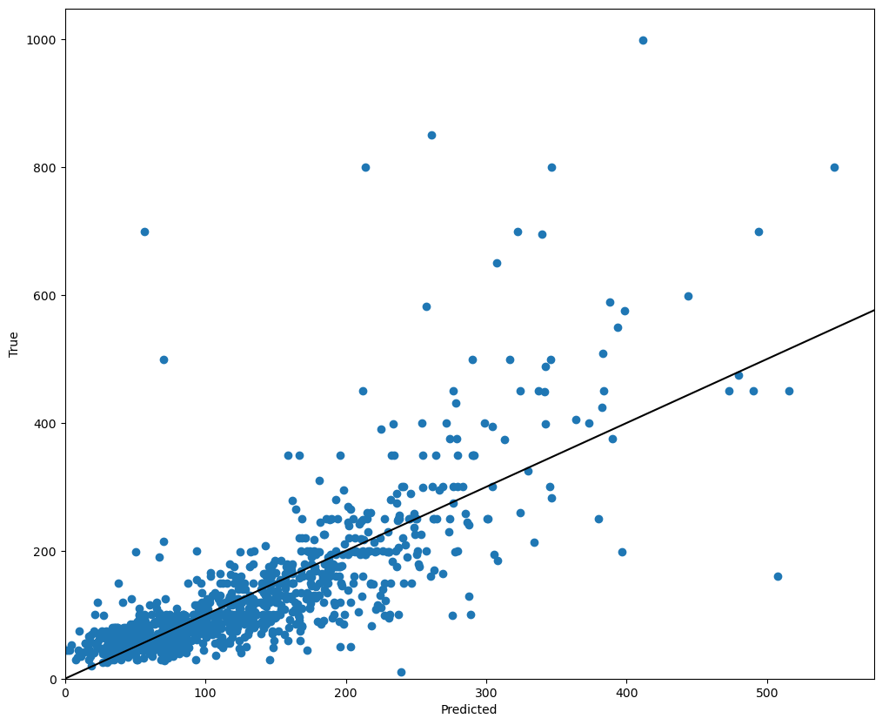
Process
Includes Real-valued data, Boolean data, Categorical data, Set data and Location:

Slide 31
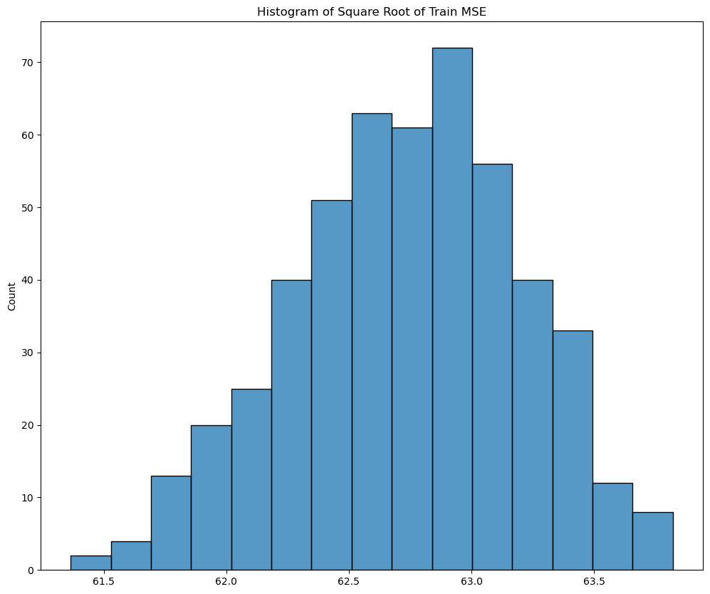
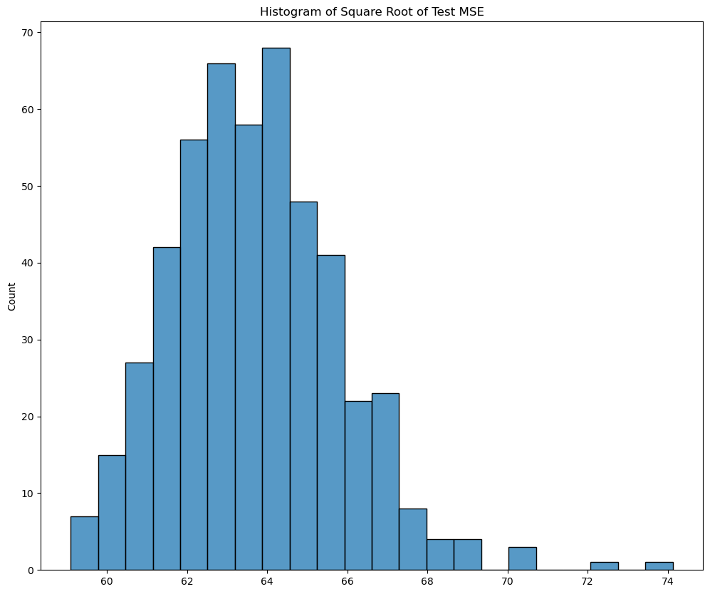
Run Train Test Split For 500 times

Slide 32
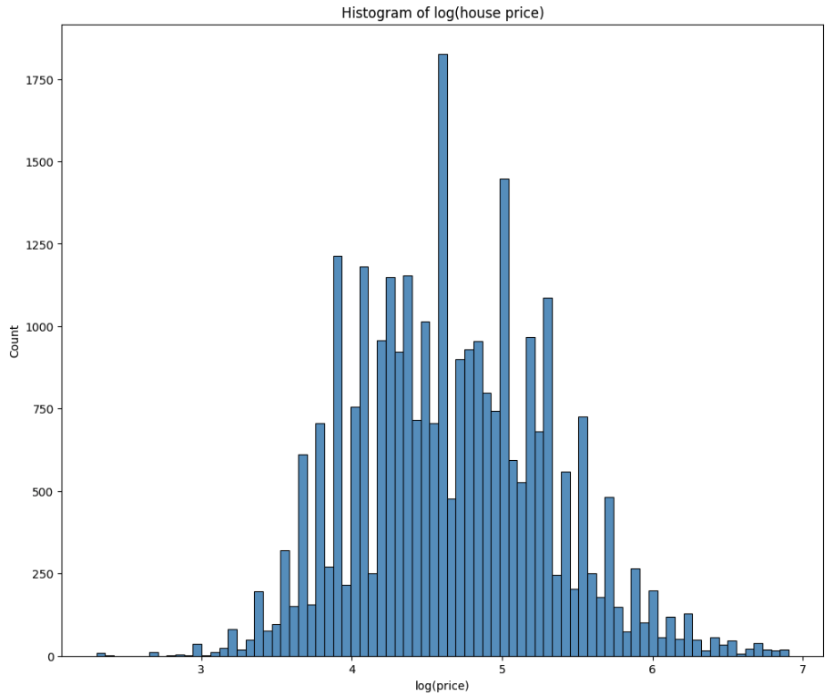
Recall the distribution of y variable (price)

Slide 33
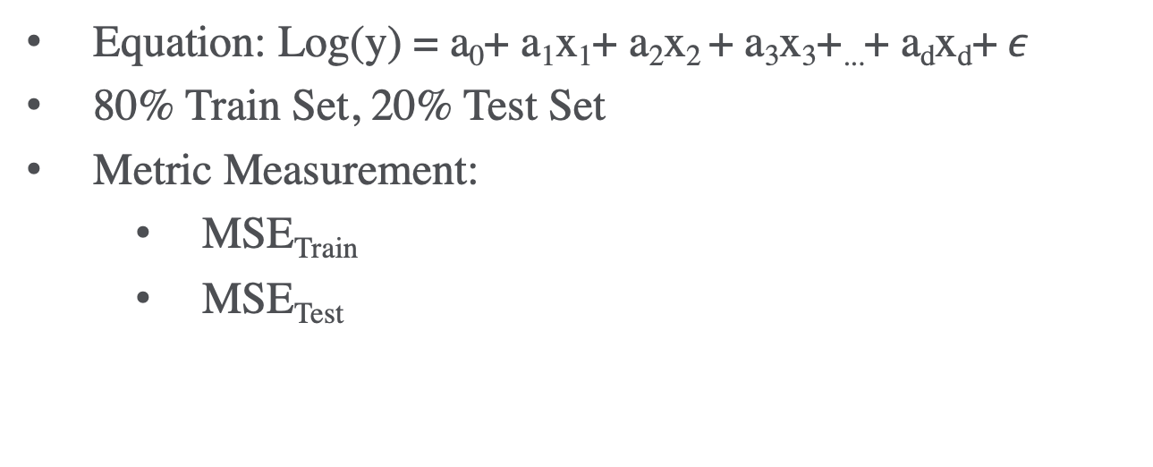
Linear Regression With Log y
Equation: Log(y) = a₀+ a₁x₁+ a₂x₂ + a₃x₃+...+ a_{d}x_{d}+$ε$
80% Train Set, 20% Test Set
Metric Measurement:
MSE_{Train}
MSE_{Test}

Slide 34
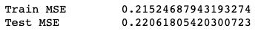
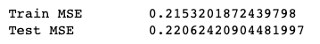
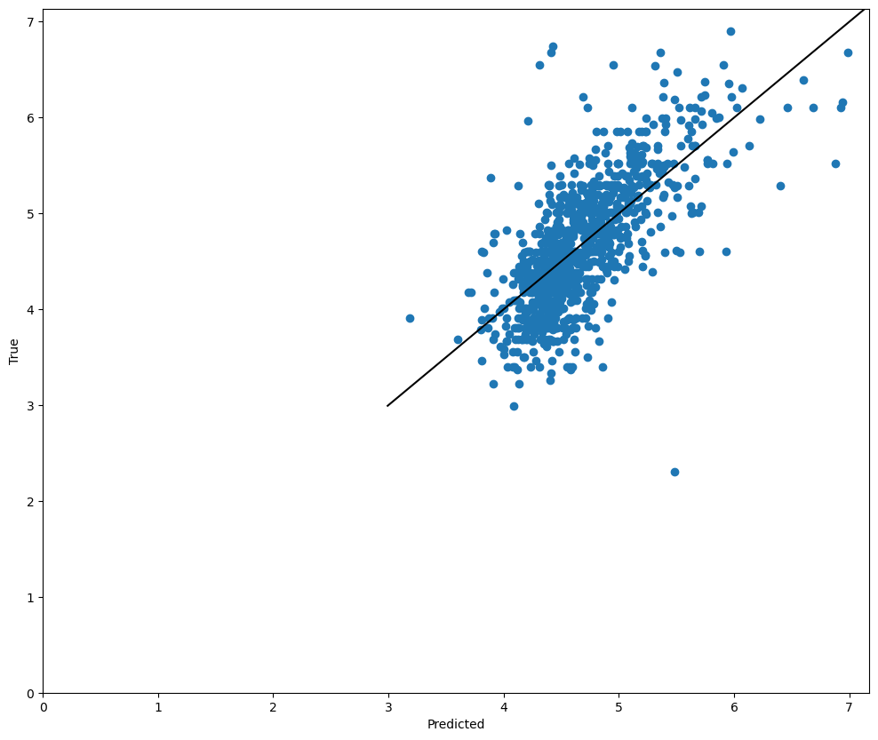
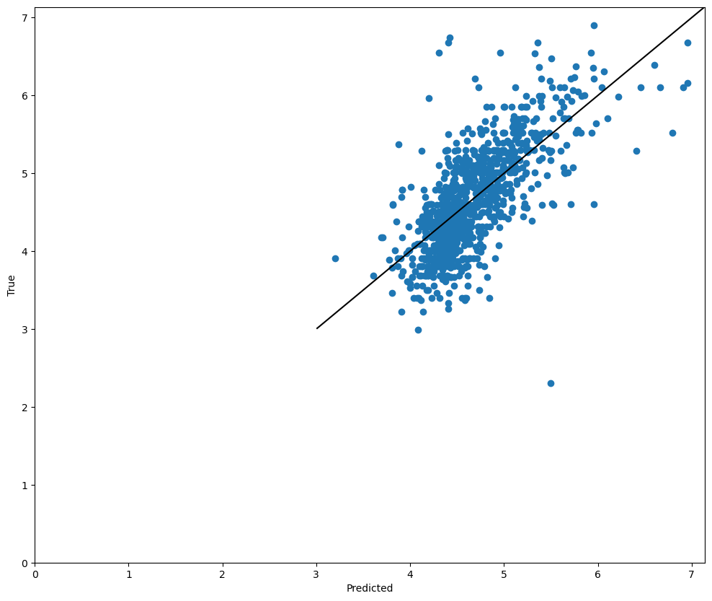
Process
Only includes real-valued data and delete columns with p-value>= 0.05:

Slide 35




Process
Includes Real-valued data and Boolean data and delete columns with p-value>= 0.05:

Slide 36


Process
Includes Real-valued data, Boolean data and Categorical data:

Slide 37


Process
Includes Real-valued data, Boolean data, Categorical data and Set data:

Slide 38


Process
Includes Real-valued data, Boolean data, Categorical data, Set data and Location:

Slide 39


Run Train Test Split For 500 times

Slide 40
Compares Linear Regression for y and log(y)
Linear model for y
Linear model for log(y)

Slide 41
Compares Linear Regression for y and log(y)
Linear Regression of y
Linear Regression of log(y)

Slide 42
Compares Linear Regression for y and log(y)
Linear Regression of y
Linear Regression of log(y)

Slide 43


Random Forest

Slide 44



Slide 45
Pros
Avoid overfitting
Flexible
Robust
Stable
Parallel
Cons
Complex
Computationally intensive
Time Consuming
Black Box Algorithm
Interpretable

Slide 46

Result
Parameter Interpretation
N_Estimators
Max_Depth
Max_Features
Min_Samples_Leaf
Min_Sample_Split
N_Iter
CV

Slide 47

XGBoost

Slide 48


Algorithm

Slide 49
Pros
Less feature engineering required
Faster
Regularization
Customized Loss function
Cons
Black Box Algorithm
Interpretation
Hard to tune hyperparameter

Slide 50

Result

Slide 51


PCA and K-means

Slide 52

Result

Slide 53
Thank you!

